Slide 1
Autism Resourced Provisions
Guidance for Parents/Carers

Slide 2

What is an Autism Support Centre (ASC)?
Some mainstream schools across Essex have extra support available for pupils with special educational needs and disabilities. These are called ‘Resourced Provisions’. The autism ‘Resourced Provisions’ are call Autism Support Centres.
Resourced Provisions are not the same as special schools: Resourced Provisions provide a bespoke space for pupils to overcome their barriers to learning within a mainstream school.

Slide 3
Why do we have Autism Support Centres?
Some autistic pupils experience barriers to accessing mainstream classrooms, for a range of reasons, related to their autism. An Autism Support Centre can offer additional support needed to remove or reduce the barriers the pupils are facing.
The process of considering a placement for a young person must be one where families, schools/settings and the Local Authority work in partnership to place young people appropriately.
The Local Authority has a clear and structured process in place for allocating places following careful consideration.

Slide 4
How are places agreed at Autism Support Centres?
New EHCP issued or change of placement requested via Annual Review
Request for placement at ASC considered by monthly Autism Panel
Place offered, or request declined, based on criteria. Information shared with family and school
Panel Membership:
Autism SEND Strategy lead, Autism Support Centre leads, SEND Operations team members, Autism outreach special school leads, Senior Specialist EP for Autism and Autism training coordinators.

Slide 5
Where are the Autism Support Centres?
Mid Essex:
Kelvedon St. Mary’s Cof E Primary Academy (Primary)
Witham Oaks Academy (Junior)
Honywood School (Secondary)
North East Essex:
Lift Hamford (Primary)
King’s Ford Academy (Junior)
Lift Tendring (Secondary)
West Essex:
Potter Street Academy (Primary)
Great Easton Primary School (Primary)
Alderton Juniors (Juniors)
Passmores Academy (Secondary)
South Essex:
Merrylands Primary School (Primary)
The Bromfords School (Secondary)

Slide 6

Entry Criteria for an ASC:
Diagnosis of autism
Has a finalised EHCP with autism as primary category of need
The cognitive ability to access the mainstream curriculum with appropriate support from the autism support centre to overcome their barriers to learning
In-line with the SEND Code of Practice, further considerations for allocating a placement:
Can the school meet the child’s needs?
Would the placement be incompatible with the efficient use of resources?
Would the placement be incompatible with the efficient education of others alongside whom the YP would be taught?
When a pupil meets the criteria above and a placement is offered, the ASC lead will co-produce a transition plan with the pupil, their family and other professionals supporting the pupil (e.g., their current school/setting).

Slide 7
Exit Criteria for an ASC:
The overall aim is to support each child to overcome any barriers they face in attending the mainstream classroom. Therefore, the amount of time spent in the ASC will reduce overtime, as the child is more able to spend increasing amounts of time in their mainstream classroom. This progress will be pupil/needs led and as a result, may look different for each pupil. An exit plan will be created to support any pupil who is ready to return to mainstream education on a full-time basis. This will be co-produced, in agreement with parents/carers and will not impact on their place at the school or transport arrangements.
Review of progress to consider:
Pupil/Family views
Progress against EHCP outcomes and in accessing the mainstream classroom
Provision required to maintain success in the mainstream classroom
Independence
Appropriateness of placement

Slide 8
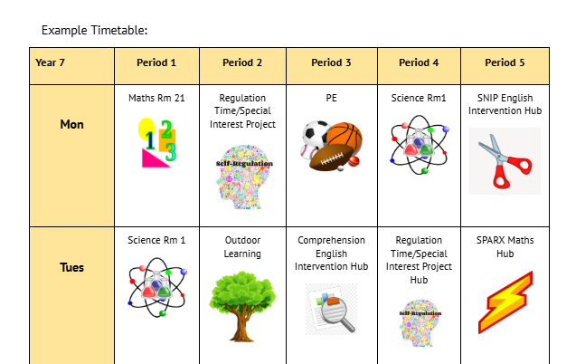
What does a day in the ASC look like for our pupils?
Pupils are greeted every morning by the ASC team. Pupils who are not yet able to attend morning class time remain in the ASC to complete structured activities which support progress towards EHCP Outcomes.
Throughout the day, pupils are encouraged to complete their individualised timetables. Visual timetables are created with the pupil’s input and are tailored to meet the pupil’s particular interests and provisions set out in their EHCP/One Plan. Most pupils will attend core subjects or complete the work set in the ASC.
Pupils will access an adaptive curriculum, designed to meet their needs. Should they become dysregulated, pupils will be supported to regulate by all staff. Regulation times will also be built into pupil timetables.

Slide 9
What does a day in the ASC look like for our pupils (continued)?
ASCs support pupils to take part in school life when it feels right for them, including social times and celebrations.
The curriculum and the support provided by the ASC are designed to help each young person gradually spend more time with the whole school community. This looks different for every pupil and happens at a pace that suits their individual needs

Slide 10
What next?
If you feel that your child meets the entry criteria, and would benefit from the provision of an Autism Support Centre:
Discuss this with your child’s current setting/school.
If you would like to proceed with a request for a placement, agree a date for an Annual Review with your child’s current setting/school.

Slide 11


This information is issued by: Essex County Council
Contact us:
autismstrategy@essex.gov.uk
Essex County Council
County Hall, Chelmsford
Essex, CM1 1QH
Essex_CC
facebook.com/essexcountycouncil
The information contained in this document can be translated, and/or made available in alternative formats, on request.
Published: Autumn 2025

